Slide 1


or
Ambassadors
Do it Like
a Big Bear
Take a
Journey
With a
Timber Wolf
Rachel Mullins Becca Jones Amanda Spinks

Slide 2
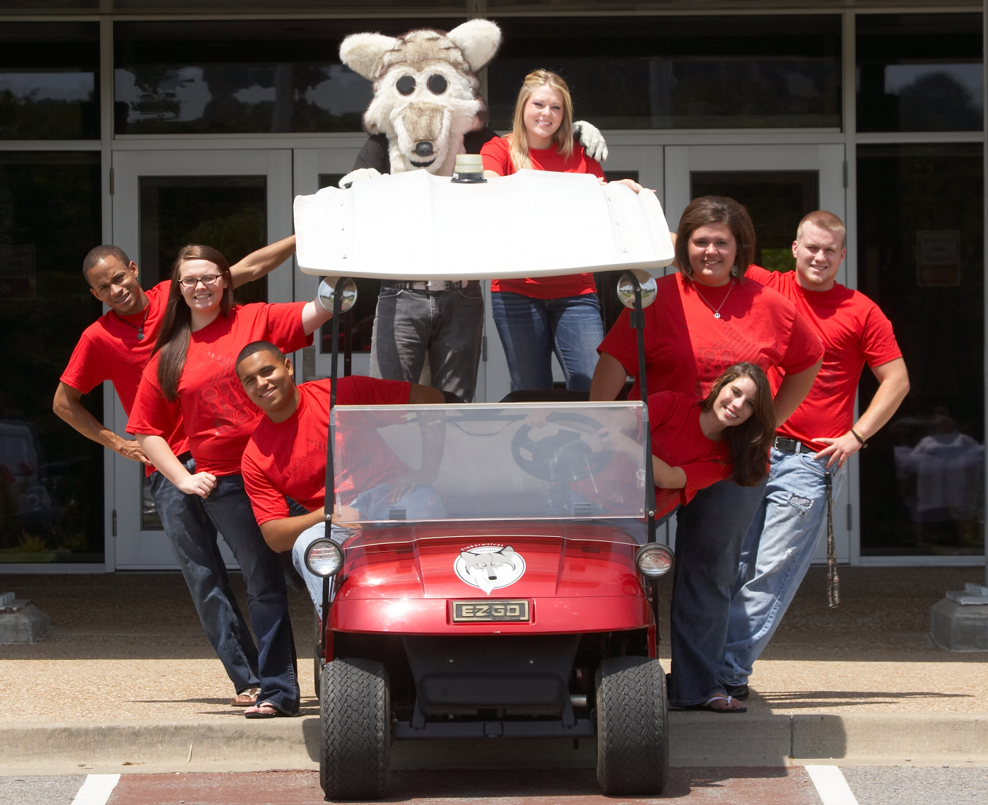
UACCM STUDENT
AMBASSADOR PROGRAM

Slide 3

AMBASSADOR PROGRAM AT uaccm
Seven Student Ambassadors
Full Tuition Scholarship
Renewable up to Two Years
Selected and Managed by the Admissions Office

Slide 4
Ambassador Selection process
Individual Interviews
  Two Counselors in Formal Interview
  Entire Office Involved in Selection Process
Group Interviews

Slide 5
Example Group activity
You are on a cruise in the middle of the ocean, and the captain of your ship drunkenly crashes the boat. As a UACCM Student Ambassador, it is your duty to determine which 5 people (besides yourself) get to ride on the rescue boat. The five you will pick will help you row to safety. The other 5 will be left at sea…
  James Jamison – the intoxicated ship captain, 53 years old
  Domingo Diaz – an elderly Hispanic man who speaks no English, 84 years old
  Trish Tubbs – a pregnant prostitute who smokes, 22 years old
  Samuel Smith – the captain’s boyfriend and navigator, 45 years old
  Dane Douglas – a single father of ten children, HIV positive, 34 years old
  Francis Fredericks – a 7 year old girl who is severely bleeding from the wreck
  Andre Anderson – Trish’s pimp, an escaped prisoner and known drug dealer, age 40
  Sally Salmon – an Olympic swimmer with a bad attitude, age 27
  Daisy Dates – a wealthy rap star whose music promotes violence, age 36
  Rhonda Riley – a mentally handicapped lady who cleans the ship, age 24

Slide 6
Ambassador responsibilities
Campus Tours
General Office Work
Tele-Counseling
Financial Aid Assistance Lab

Slide 7
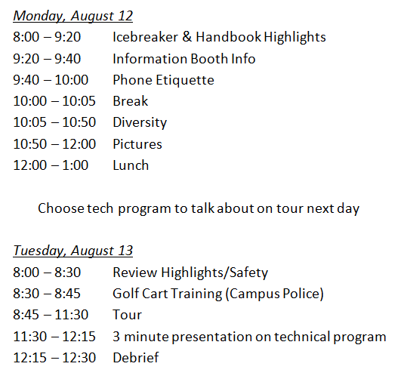
Ambassador training
Fall Training

Slide 8
Ambassador training
Spring Training
  Set goals for the semester
    Assist prospective and current students with completing the FAFSA and YOUniversal application
    Inform prospective and current students of UACCM scholarships
    Inform prospective and current students of some common funding resources and provide contact information

Slide 9
Ambassador renewal criteria
128 Hours of Service (8 hours per week)
2.5 GPA
Satisfactory Work Performance
Ambassador Exam
  Oral Exam First Semester
  Written Exam for Returning Students

Slide 10
Ambassador project
Encourages Lifelong Community Service
Strictly Volunteer
Two to Three Fundraisers Events Per Semester
  Silent Action Sept. 18-24
  Soup & Sandwich Lunch Nov. 6
General Fund

Slide 11
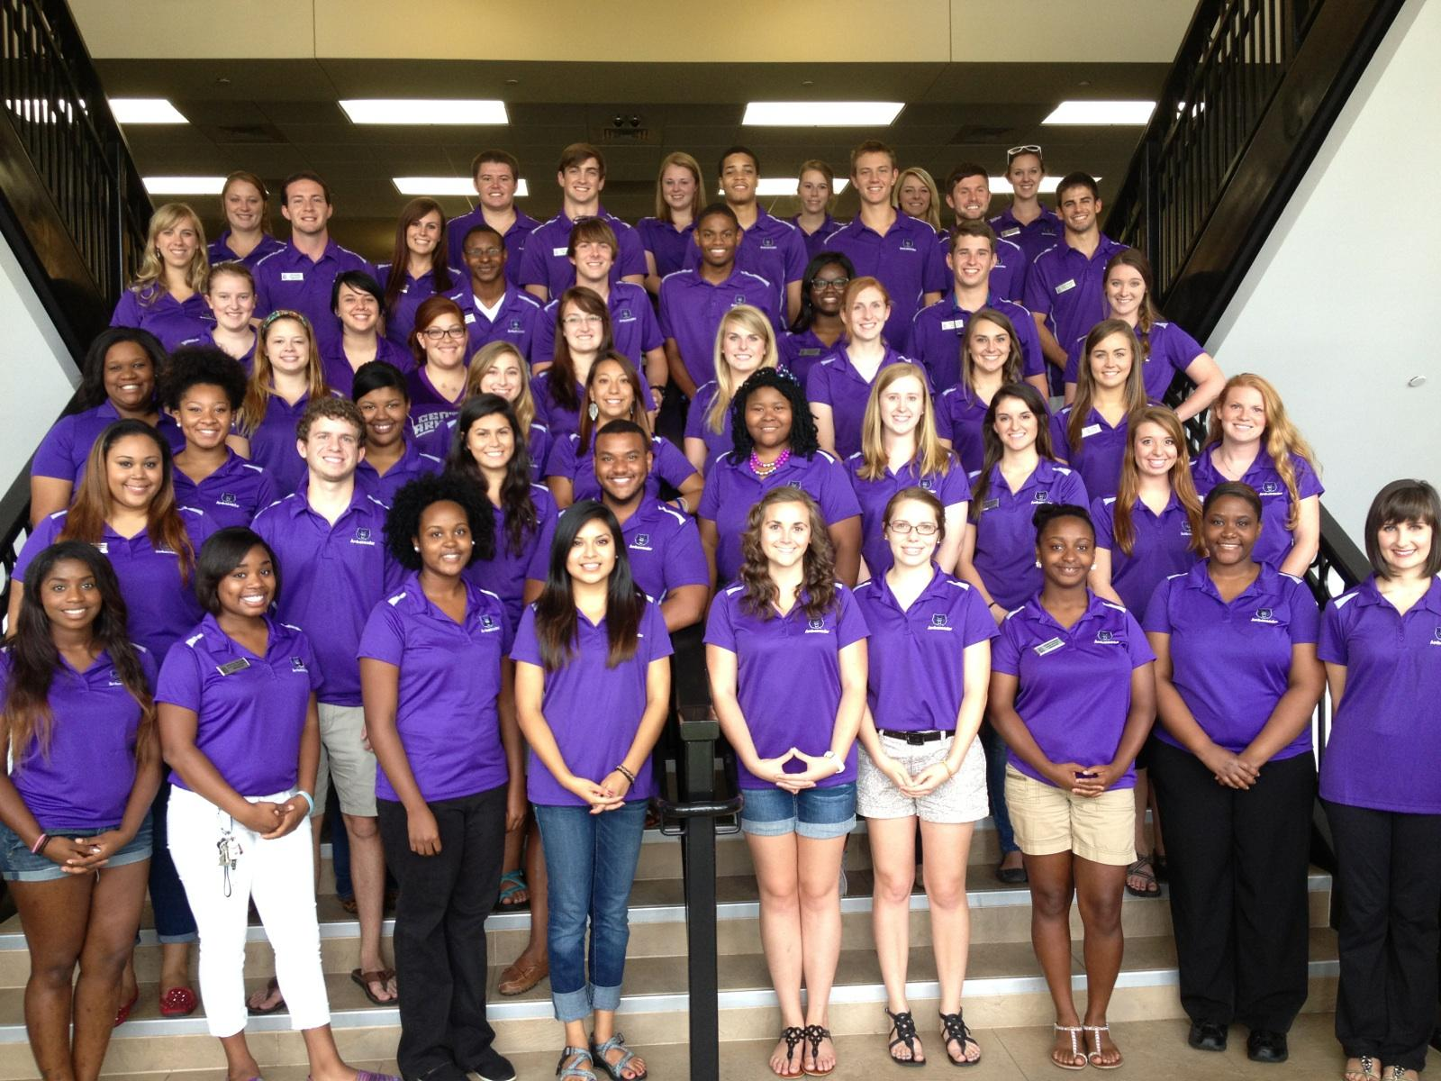
The 2013-2014
UCA Ambassadors

Slide 12
Who are Ambassadors?
Cross-section of Student Body
Diverse
Responsible
Flexible
Willing to Volunteer Time
Notes:
Volunteering to be an Ambassador means that you hold a highly‐sought position of leadership and public exposure on our campus. We seek students from a variety of backgrounds with varied interests, opinions, and experiences to represent the variety of students that visit and apply to UCA. This year we have 67 students who have been selected. As well as being involved with Ambassadors, many are involved in several other organizations on campus. This year we have representatives from Honors College, Greek Life, Student Government Association, Bears Den Executive Board, and Bear Marching Band.

Slide 13
How are they chosen?
Applications
  Returning students as well as new students must complete the application
GPA Requirement
Applications evaluated by UCA Admissions staff
Interview Process
Notes:
Applications go out in February, due in March. Must turn in entire application as well as letter of recommendation from a UCA staff or faculty member.
125 applications this year, interviewed 85 students.
GPA requirement of 2.5. This year, we only interviewed students with a 3.0 or above.
Group interview. Admissions staff and returning Ambassadors sit in. Mini tour of Student Center.

Slide 14
What do Ambassadors do?
Attend Ambassador Training Day
Minimum of 5 regularly scheduled tours per semester
Minimum of 2 special tours per semester
Work select Bear Facts Days
Visit their high school
Attend monthly meetings
Special projects
Notes:
During the 2012-2013 year our Ambassadors toured 1,679 prospective students on a traditional campus tour.
1,709 students on a “Special Tour”
2,243 students on Bear Facts Days

Slide 15
What Makes Our Program Tick
Application/Interview
Training Day
Structure
Teams
Meetings
Prizes
Banquet

Slide 16
The Application and Interview Process
Applications turned in to Admissions Office
Director(s) review applications
Call to schedule interview
Group Interview
  2 to 4 students
Admissions Staff and Returning Ambassadors
Thirty minutes
Mock Tour
Notes:
This year we had around 125 applications. We went through each application and decided to only interview those with a 3.0 or above for Round 1. For Round 2 we looked at 2.8 and above. We also require a letter of recommendation from a UCA staff or faculty member. We ended up interviewing about 59 new students along with 29 returning Ambassadors. Interviews were 30 minutes long with 2 to 4 students per interview. They were interviewed by the Director(s), Admissions staff, and returning Ambassadors. Scenarios, background information, and a mock tour.

Slide 17
Training Day
History of UCA
Tour Training
Conversation Training
Expectations and Rewards
Manual
Notes:
History lesson done by UCA’s on campus historian, Jimmy Bryant. Tour training led by the Team Leaders. Conversation training done by Team Leaders and UCA Admissions Counselors. Rewards=star system.

Slide 18
Ambassador Structure
Director
(UCA Staff)
President
Team Leader
Team Leader
Team Leader
Team Leader
Team Leader
Team Leader
“Newbies” & “Returners
“Newbies” & “Returners
“Newbies” & “Returners
“Newbies” & “Returners
“Newbies” & “Returners
“Newbies” & “Returners
Notes:
Team Leaders and President make up the Ambassador Exec Board. Make decisions on how punishment is handled.

Slide 19
Teams
6 Teams
Led by “Returners”
  Voted on by peers
  Receive special training
Required Team Outings
Notes:
During the interview process for Returners were asked if they were interested in being a Team Leader. Those who expressed interest were then voted on by the 2012-2013 Ambassadors. The Team Leaders are responsible for assisting with training their team on Training Day. They are also given special training with Admissions Staff to prep them for the year. Another important thing about the teams is the required team outings. Each Team Leader is required to organize two Team Outings per semester. They can go bowling, roller skating, rock climbing, or grill out. The most important thing is that they are interacting with one another and getting the chance to really become invested in the program.

Slide 20
Meetings
Monthly meetings
Required attendance
Ice Breakers
Updates
Prizes

Slide 21
Prizes & Banquet
Sticker Board
Prizes – year specific
End of Year Banquet
  Outstanding Achievement
  No Blue Dot
  Legacy Award
Notes:
5 stars – sunglasses
10 stars – anorak (first years), fleece (second years), hoodie (third years)
15 stars – long sleeve shirt
20 stars – blanket
25 stars – camping chair

Slide 22
PLEASE SHARE BEST PRACTICES

